Slide 1
DSL Productization
Anuparna Ganguly
07/07/2025

Slide 2
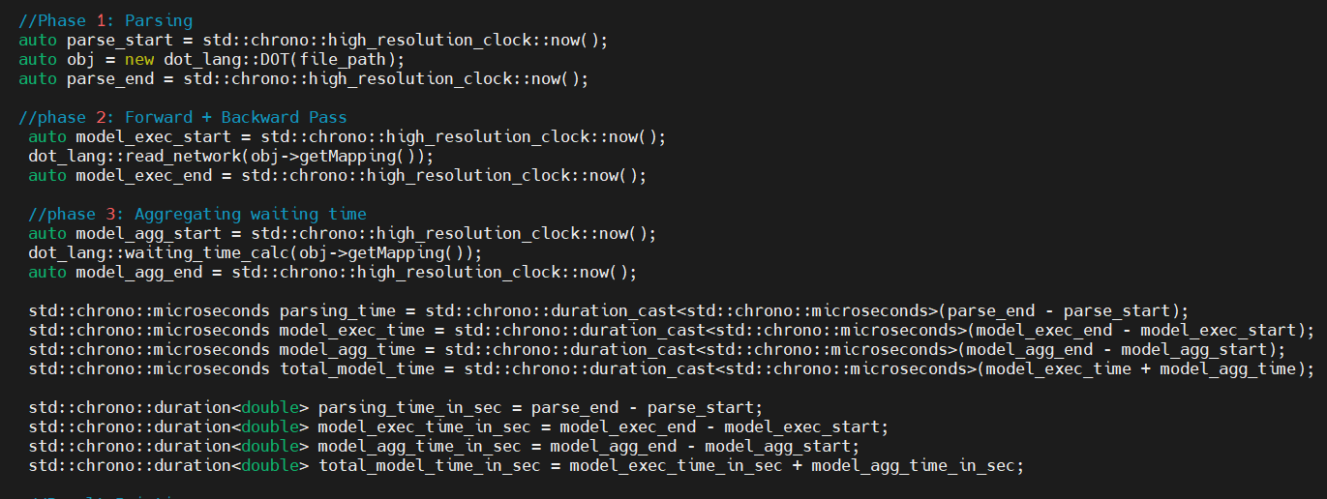
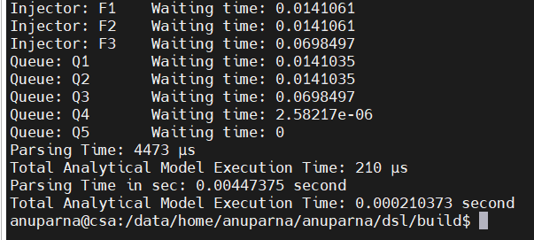
Execution Time Analysis
Phase 1: Parsing
auto obj = new dot_lang::DOT(file_path);
Parses the .dot file and initializes objects.
Phase 2: Forward + Backward Pass
Build networks, computes individual waiting times.
Aggregation(Final waiting time calc):
Sums up queue waiting times to compute total latency of any injector.
Timer:
1.Parser Time.
2.Analytical Core(Fwd/Bwd pass)
3.Aggregation(Final calc)
4.Total Analytical = Analytical Core(Fwd/Bwd pass) + Aggregation(Final calc)
Output of RR followed by PR

Slide 3
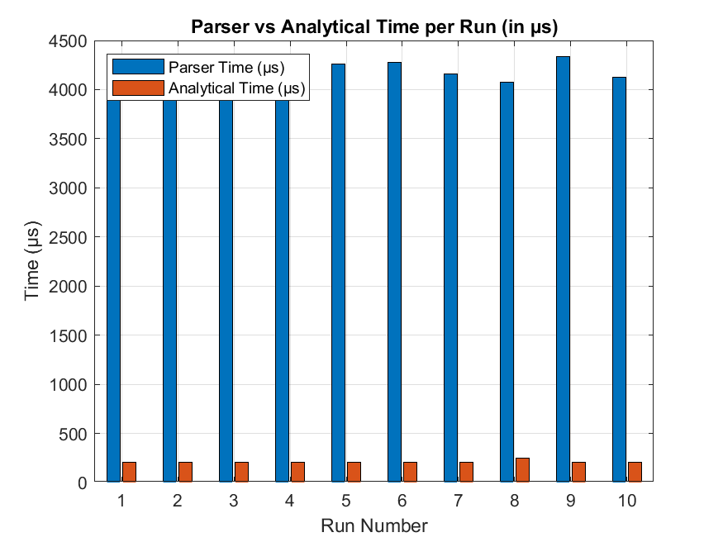
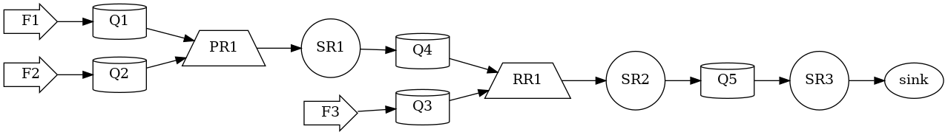
Execution Time Analysis( RR followed by PR)
Without Print statements
With Print statements
Run | Parser(s ) | Analytical Model (s )
1. | 0.003909 | 0.000206
2. | 0.004169 | 0.000206
3. | 0.003892 | 0.000205
4. | 0.004164 | 0.000207
5. | 0.004262 | 0.000207
6. | 0.004278 | 0.000206
7. | 0.004157 | 0.000208
8. | 0.004079 | 0.000247
9. | 0.004338 | 0.000204
10. | 0.004125 | 0.000204
Average | 0.0041373 | 0.0002067
Run | Parser(s ) | Analytical Model (s )
1. | 0.004393 | 0.000257
2. | 0.004496 | 0.000215
3. | 0.004611 | 0.000208
4. | 0.004477 | 0.000205
5. | 0.004473 | 0.000205
6. | 0.004461 | 0.000205
7. | 0.00444 | 0.000207
8. | 0.004254 | 0.000208
9. | 0.004412 | 0.000208
10. | 0.004096 | 0.000216
Average | 0.0044113 | 0.0002134

Slide 4
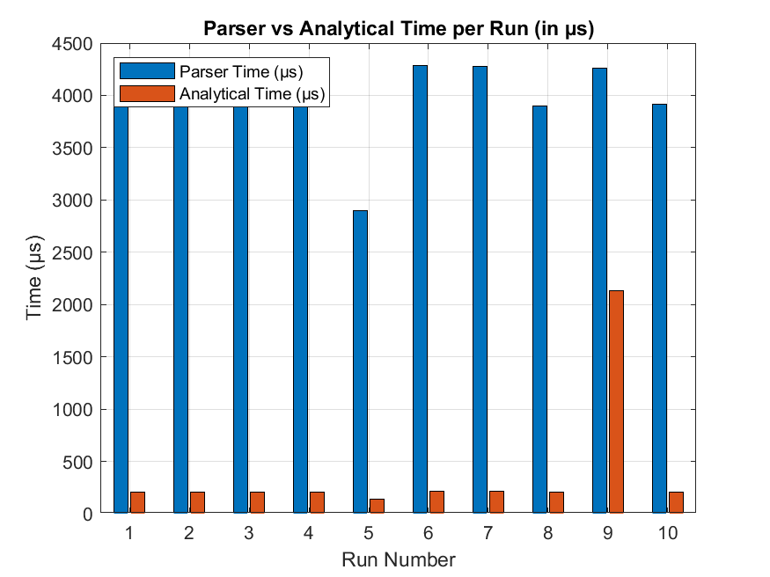

Execution Time Analysis( PR followed by RR)
Without Print statements
With Print statements
Run | Parser(s ) | Total Analytical (s )
1. | 0.00409 | 0.000209
2. | 0.003976 | 0.000207
3. | 0.004313 | 0.000206
4. | 0.003895 | 0.000205
5. | 0.002898 | 0.00014
6. | 0.004282 | 0.000215
7. | 0.004282 | 0.000212
8. | 0.003901 | 0.00021
9. | 0.00426 | 0.000213
10. | 0.003918 | 0.000206
Average | 0.0039815 | 0.0002023
Run | Parser(s ) | Total Analytical (s )
1. | 0.00419843 | 0.000213156
2. | 0.00444006 | 0.000213287
3. | 0.00448252 | 0.000210042
4. | 0.00453139 | 0.000213076
5. | 0.00436324 | 0.000213897
6. | 0.00442218 | 0.000211254
7. | 0.00448527 | 0.000219056
8. | 0.00445862 | 0.000213577
9. | 0.00409371 | 0.000219046
10. | 0.00445079 | 0.000211763
Average | 0.004392621 | 0.000213815

Slide 5
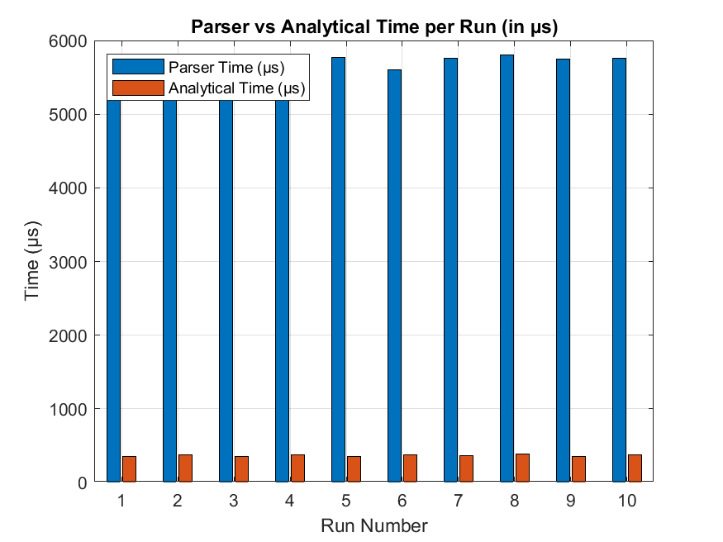
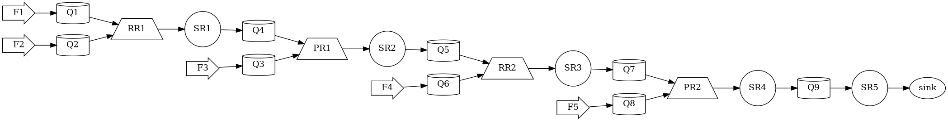
Execution Time Analysis( RR1 -> PR1 -> RR2 -> PR2)
Without Print statements
With Print statements
Run | Parser(s ) | Total Analytical (s )
1. | 0.005478 | 0.000349
2. | 0.005811 | 0.000378
3. | 0.00556 | 0.000354
4. | 0.005749 | 0.000374
5. | 0.005766 | 0.00035
6. | 0.005598 | 0.000373
7. | 0.005759 | 0.000361
8. | 0.005803 | 0.000384
9. | 0.005751 | 0.000354
10. | 0.005756 | 0.000372
Average | 0.005703 | 0.000365
Run | Parser(s ) | Total Analytical (s )
1. | 0.00594467 | 0.000379441
2. | 0.00597244 | 0.000381094
3. | 0.00608743 | 0.000355836
4. | 0.00610621 | 0.000380674
5. | 0.00611014 | 0.000375666
6. | 0.00608787 | 0.000380143
7. | 0.00612777 | 0.000356787
8. | 0.00605418 | 0.000411049
9. | 0.00611573 | 0.000357327
10. | 0.00574792 | 0.000356817
Average | 0.006035436 | 0.000373483

Slide 6
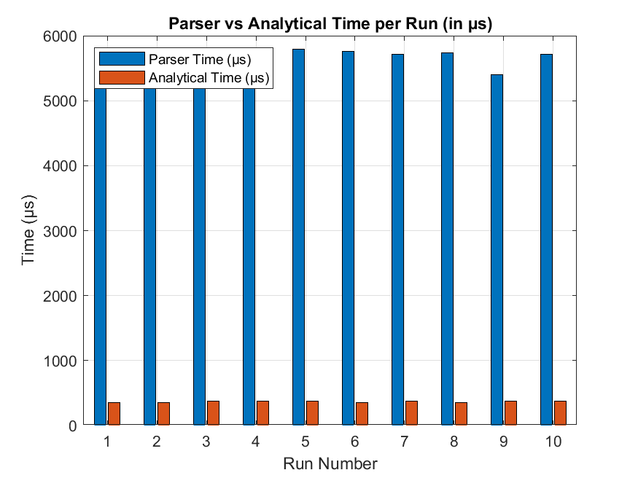

Execution Time Analysis( RR1-> PR1->PR2->RR2)
Without Print statements
With Print statements
Run | Parser(s ) | Total Analytical (s )
1. | 0.00539 | 0.000348
2. | 0.00579 | 0.000354
3. | 0.005365 | 0.000372
4. | 0.00538 | 0.000378
5. | 0.005787 | 0.000375
6. | 0.005754 | 0.00035
7. | 0.005715 | 0.000373
8. | 0.00574 | 0.000348
9. | 0.005401 | 0.000372
10. | 0.005718 | 0.00038
Average | 0.005604 | 0.000365
Run | Parser(s ) | Total Analytical (s )
1. | 0.00610127 | 0.000357949
2. | 0.00564132 | 0.000372491
3. | 0.00569142 | 0.000354163
4. | 0.00601796 | 0.000357047
5. | 0.00613454 | 0.000379752
6. | 0.00608975 | 0.000381505
7. | 0.00585242 | 0.000377289
8. | 0.0057402 | 0.000338329
9. | 0.00599963 | 0.000387864
10. | 0.00576694 | 0.000380363
Average | 0.00576694 | 0.000368675

Slide 7
Future Work
We plan to profile memory consumption during parsing and analytical processing.
So far, we have analyzed how much time our model takes for different configurations.
In the next phase, we will focus on memory usage.
We plan to profile memory consumption during parsing and analytical processing.
This will help us understand how much RAM is used and optimize the model further

